Slide 1
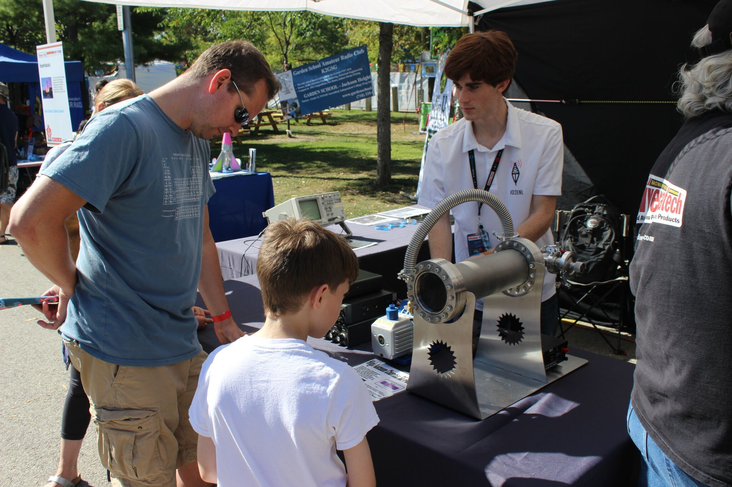
What is Amateur Radio?
Amateur Radio, also known as “ham radio,” is a popular service and hobby that enables so many activities - from public service, to scientific experimentation, to sheer fun.

Slide 2
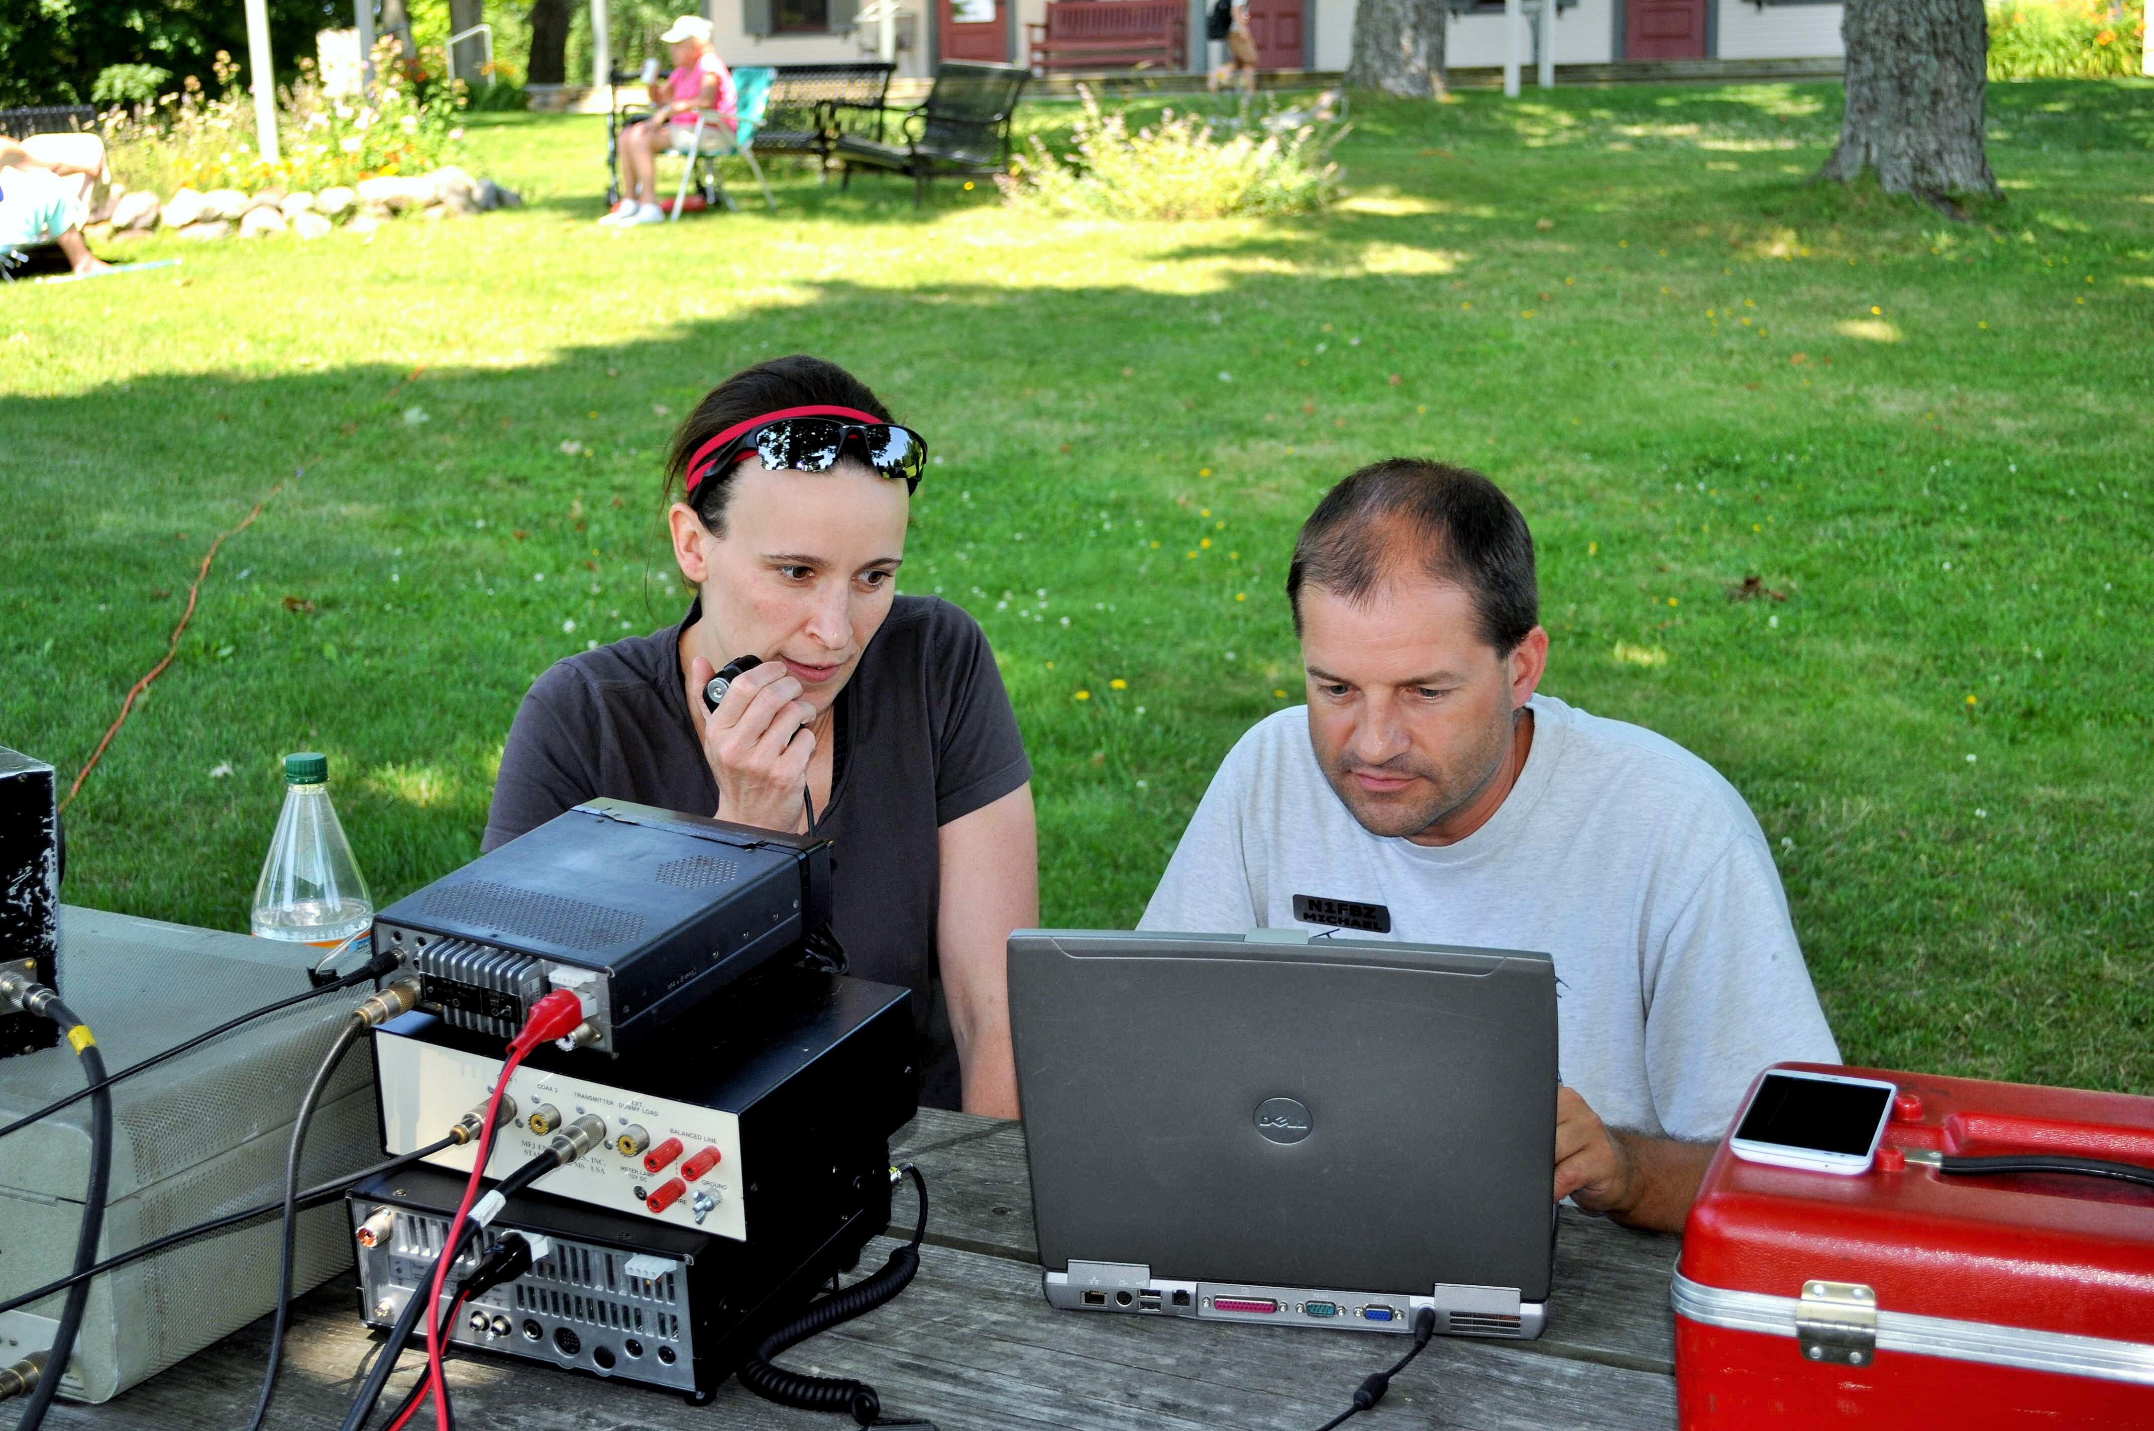
All around you…
With more than 740,000 practitioners in the US and 1.75 million worldwide, there are federally licensed Amateur Radio operators everywhere - in your neighborhood, in your workplace, and in your schools.

Slide 3

Wherever you go…
People just like you use ham radio to communicate without relying on the internet or a cell phone network, and it can go wherever you go. You can hike a trail, climb a mountain, or paddle a river, and take your radio with you.

Slide 4
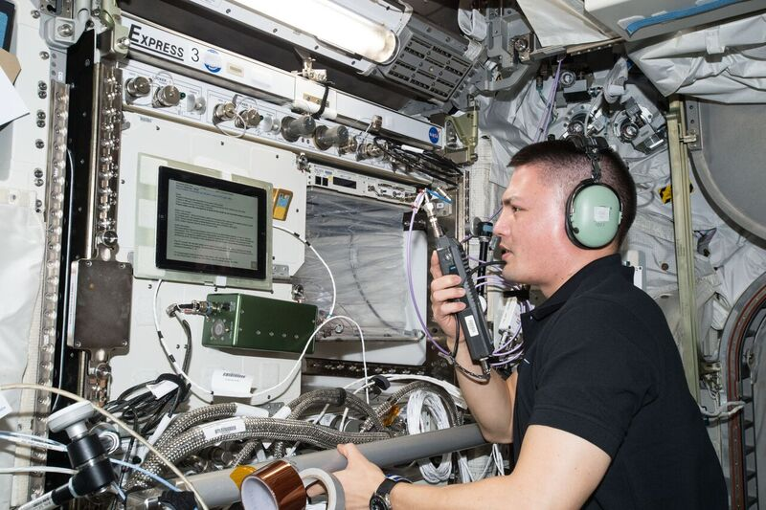
Outer space…
Ham radio even reaches as far as outer space. Ham radio operators can talk to astronauts aboard the International Space Station, talk to other operators through satellites orbiting Earth, and even bounce their radio signals
off the moon and back.

Slide 5
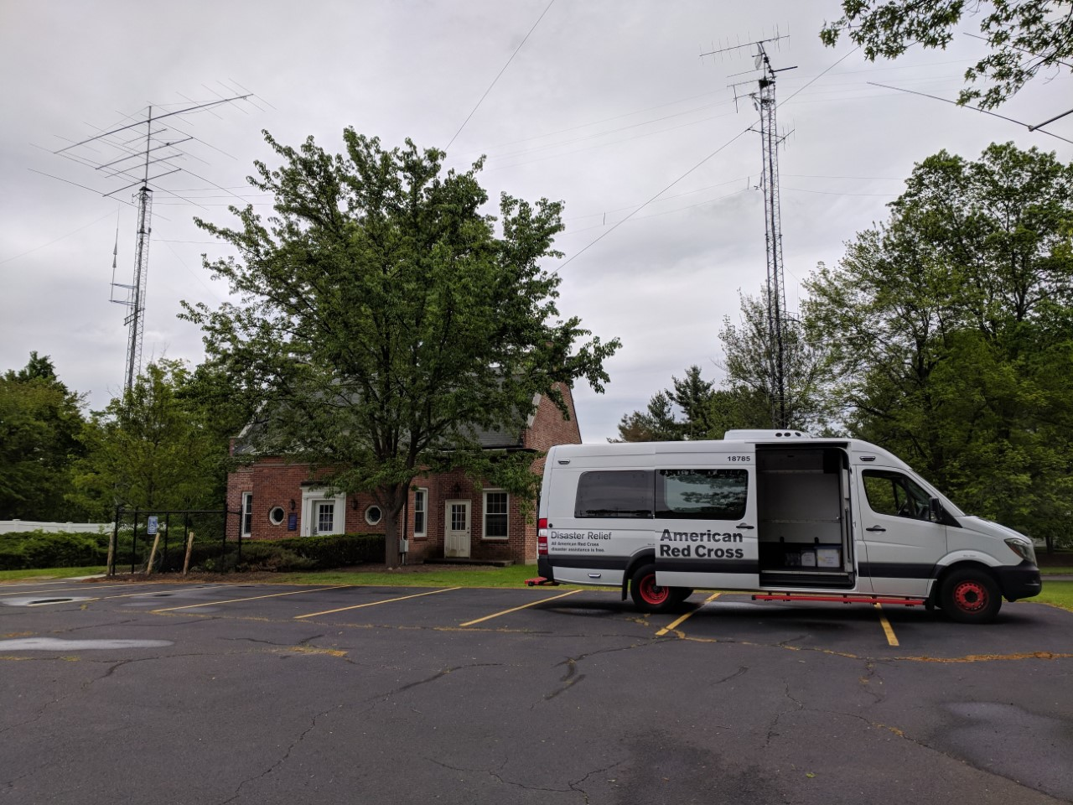
Public service…
The Amateur Radio Service is a valued element of neighborhoods and municipalities across the US. In
times of disaster, when regular communications
channels fail, the Amateur Radio Service works
with public service agencies…

Slide 6
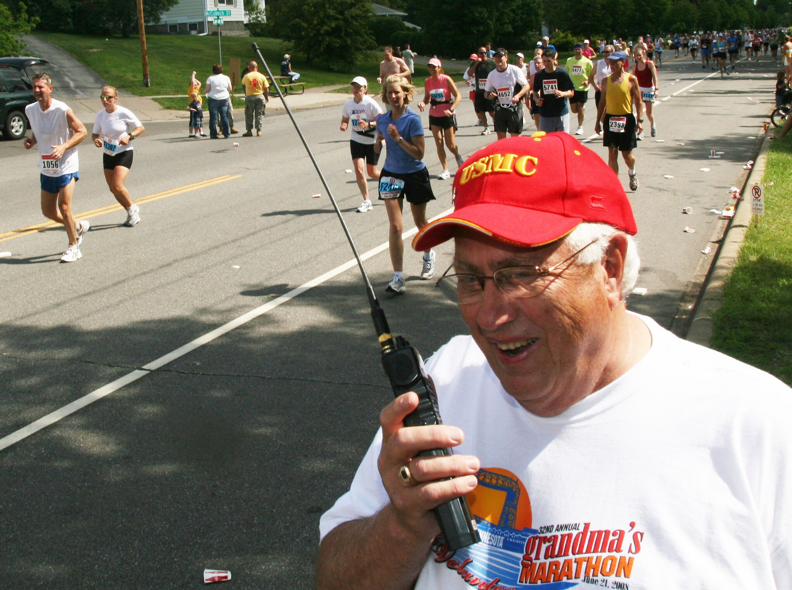
Community events…
…such as FEMA, the American Red Cross, and the Salvation Army to assist emergency communications efforts. Amateurs can also use their radios to volunteer within their communities, providing communications for events like county fairs, parades, and road races.

Slide 7
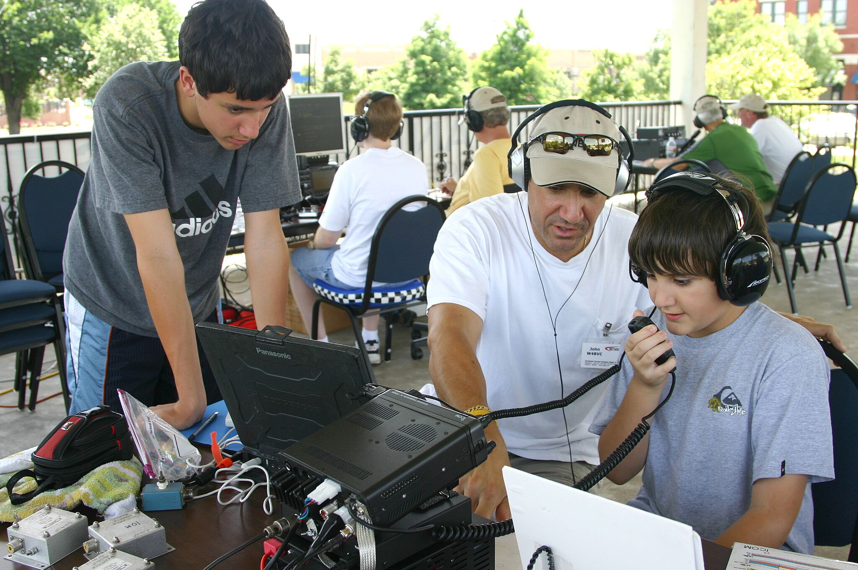
Get licensed…
Although people get involved with Amateur Radio for many reasons, they all pass a test to earn the Federal Communications Commission license that shows they have
a basic knowledge of the principles of electricity, radio technology, and operating rules.

Slide 8
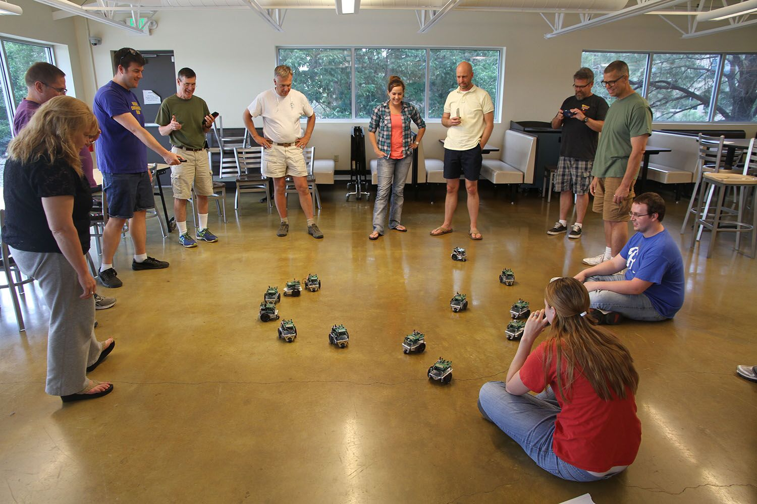
Education…
This knowledge has practical, everyday applications that educators have used to teach science, technology, engineering, and math concepts. Lots of hams got into the hobby as kids and followed their interest in radio to exciting careers as astronauts, engineers, pilots, and more.

Slide 9
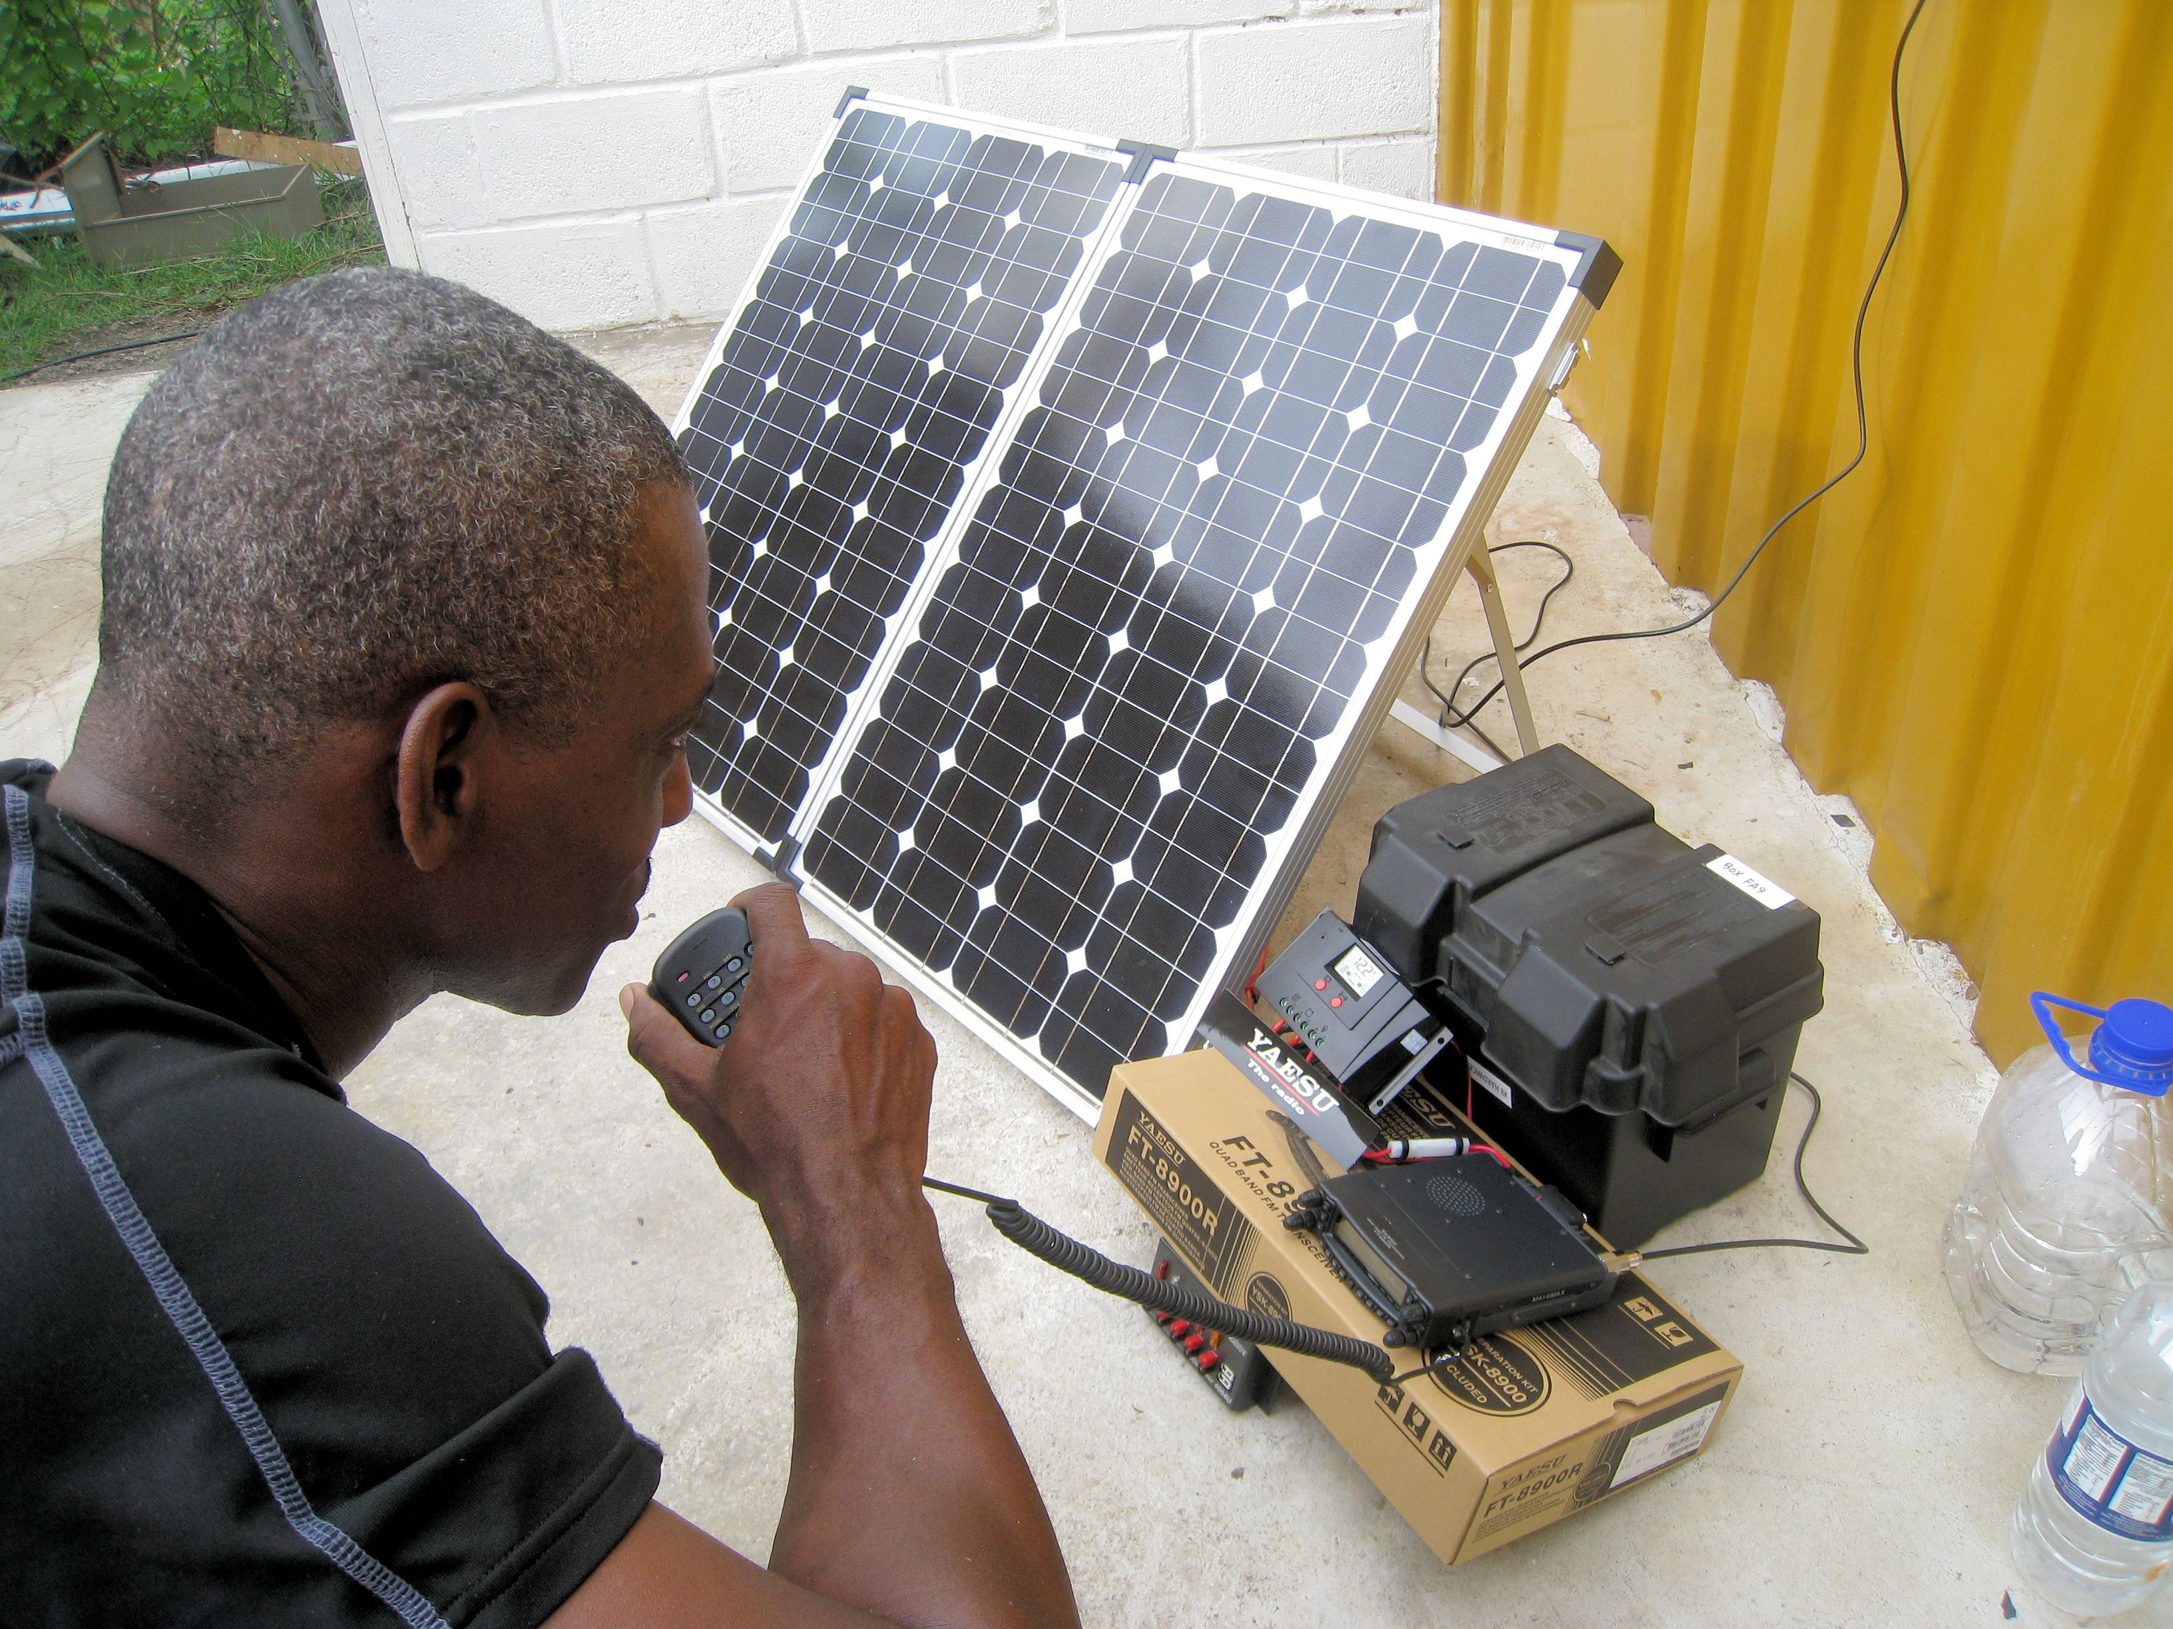
Communication…
The ham radio frequencies begin below the AM broadcast band, and extend into extremely high microwave
frequencies. Ham radio operators use these
frequencies to communicate with each other…

Slide 10
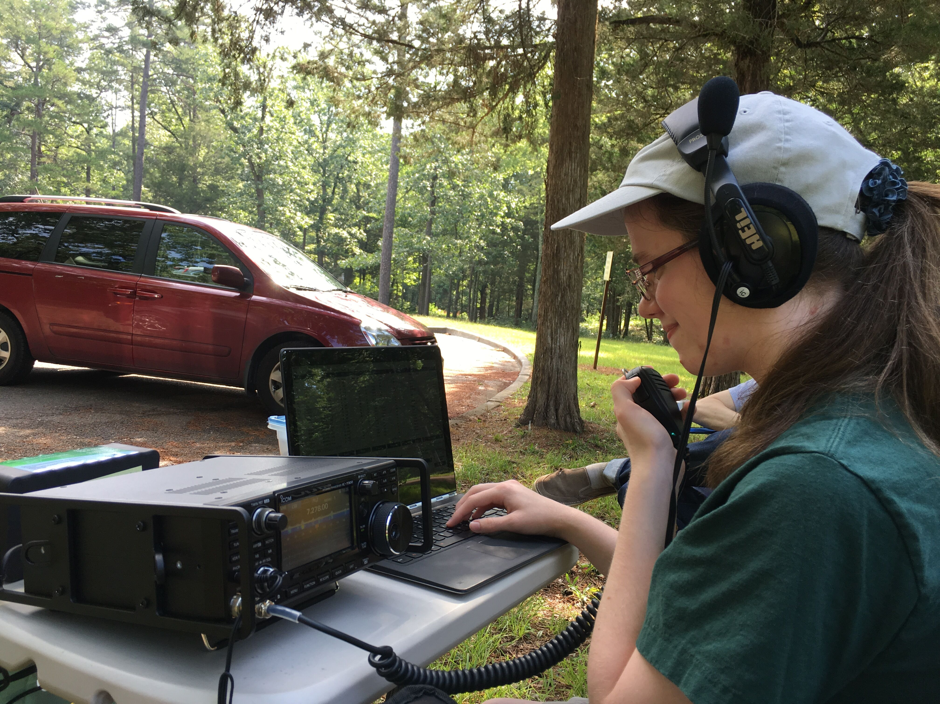
Contesting…
…using microphones, Morse code, and even by interfacing
a radio with a computer or tablet to send data, text, or images. Some compete in contests, trying to make the
most radio contacts within a certain timeframe.

Slide 11
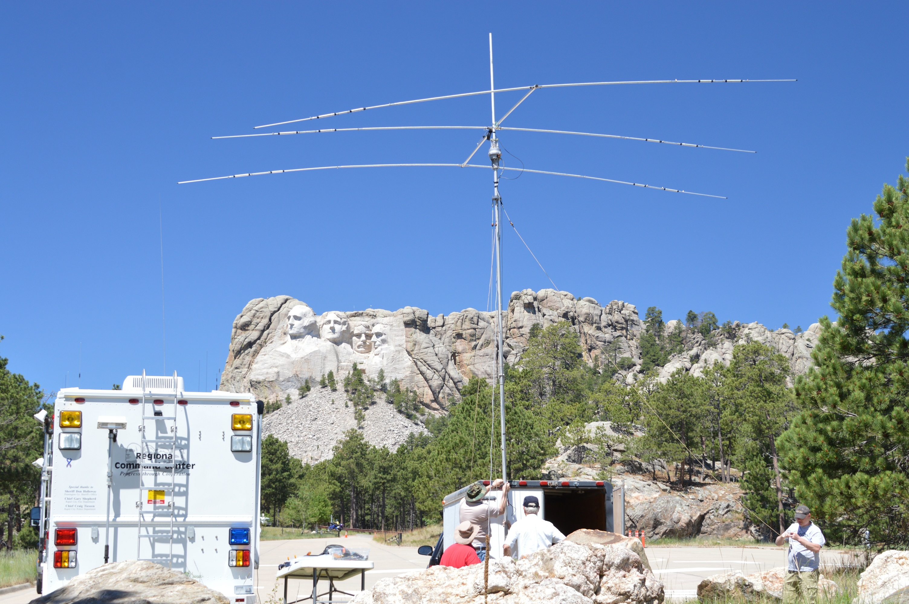
Technology…
Amateur Radio has been around for over
100 years, and the technology behind it
continues to evolve and advance today.

Slide 12
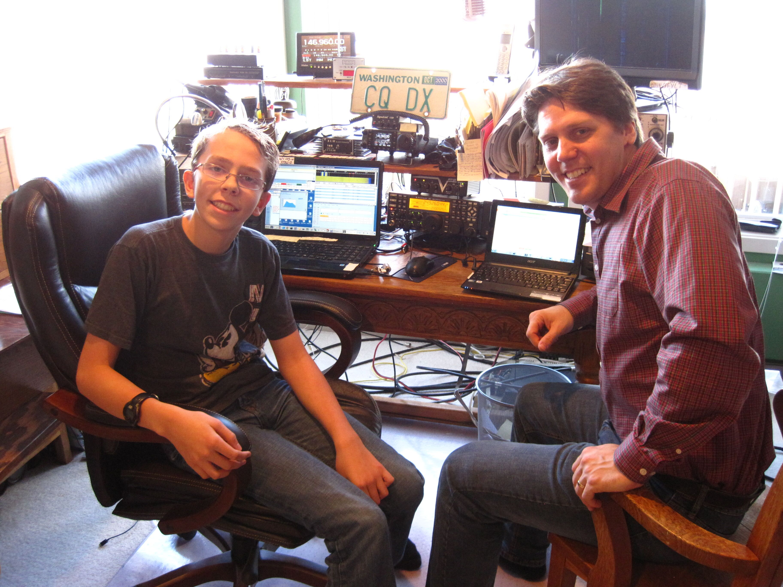
New ways to explore…
Operators are always finding new ways to explore
Amateur Radio, experimenting with digital
applications of this technology through things
like coding, mobile apps, and drones.

Slide 13
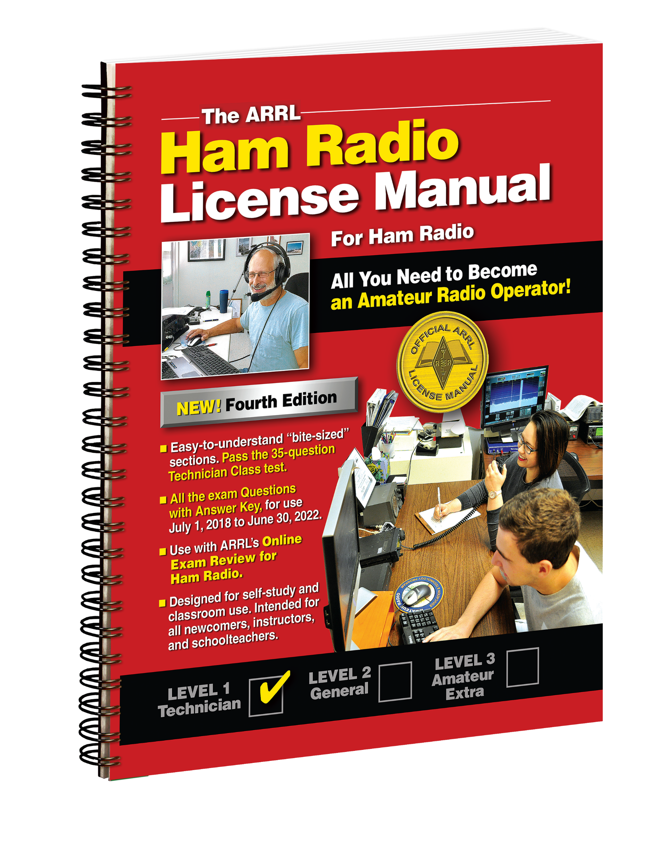
Your First Step to Getting on the Air!
The ARRL Ham Radio License Manual will guide you as you
get started in the hobby–as you select your equipment, set-up
your first station and make your first contact.
Easy-to-understand “bite-sized” sections. Pass the 35-question Technician Class license test.
Includes the latest question pool
with answer key, for use through
June 30, 2022.
Convenient Spiral Bound Edition
lies flat.
Use with ARRL’s online Exam Review
for Ham Radio.­­
www.arrl.org/shop/ham-radio-license-manual

Slide 14
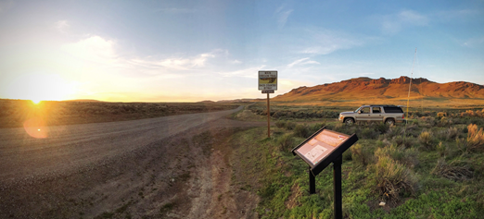
To learn more…
To learn more about the endless possibilities of
Amateur Radio, where the technology is headed,
and how you can get involved, visit
ARRL, the national association for Amateur Radio® at
www.arrl.org

